Slide 1
Case Study – Lending Club
Objective:
A Presentation on-
1. Informing the EDA analysis made as part of case study and
2. Stating a set of Driving Factors for possibility of Loan Defaulting.
Thus minimise the risk of losing money while lending to customers.
Authors:
1. Abhishek Tyagi
2. Praveen Padmanabhuni

Slide 2
Data Cleaning
Columns:
1. Remove all the columns after 50(AX)
All columns after column 50 are empty or have single value. So, we decided to remove all these columns
2. Remove few of the Customer Behaviour Variables
Few of these variables cannot be available at time of loan application.
Rows:
1. Remove rows that are empty
Removed rows that are empty across multiple columns
2. Remove rows of applicants not useful for analysis
Removed rows of applicants whose loan status is Current

Slide 3
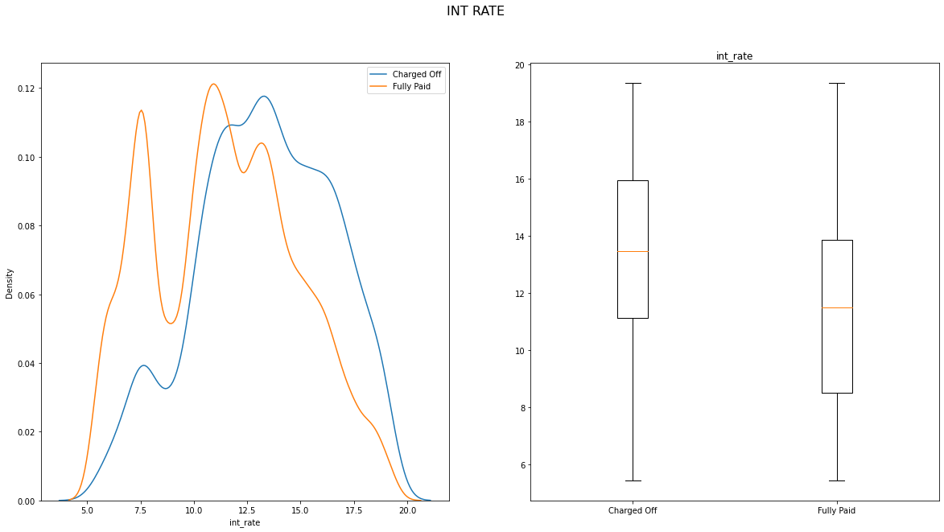
Driving Factor : Interest Rate (int_rate) EDA Type: Univariate Analysis Graph Type: Density Plot, Box Plot Analysis: As the graphs inform, 1. In Density plot, beyond a certain interest rate there is a clear shift for Charged Off 2. In Box plot, the 25%,Median and 75% are clearly at high interest rates for Charged Off.

Slide 4
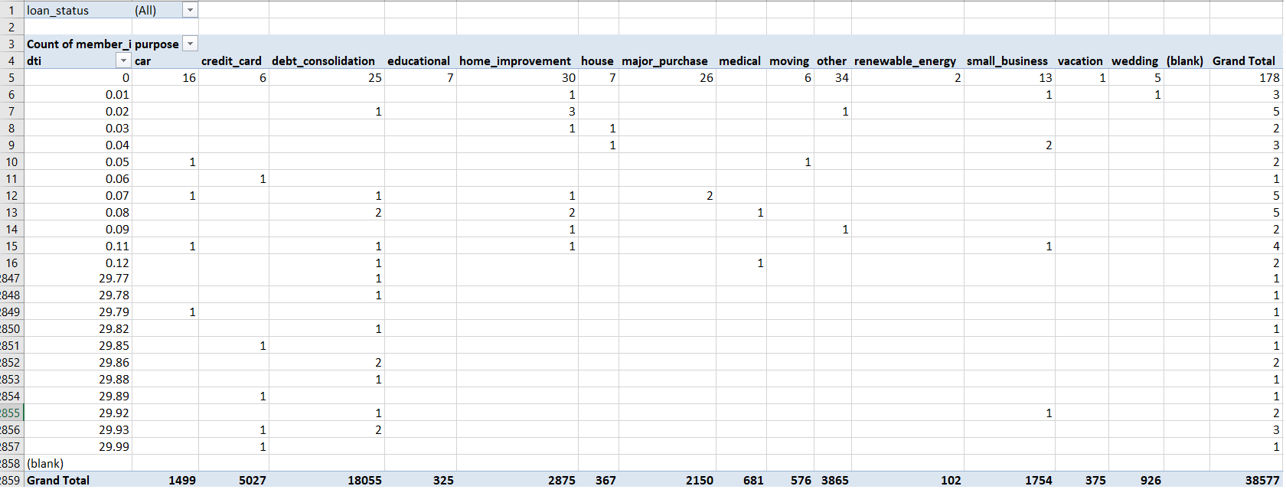
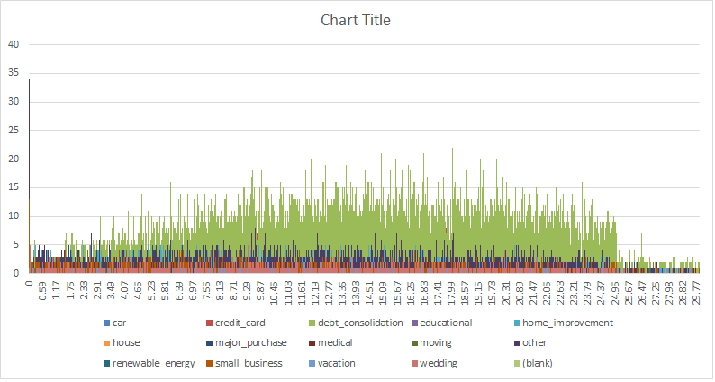
Driving Factor : Purpose EDA Type: Multivariate Analysis Graph Type: Pivot Table, Bar chart Analysis: 1. From Pivot table, Applicants for purpose of Small Business has high chance for Loan defaulting. For purpose as "small business" default percentage: is 27.08% and is high amongst other factors

Slide 5
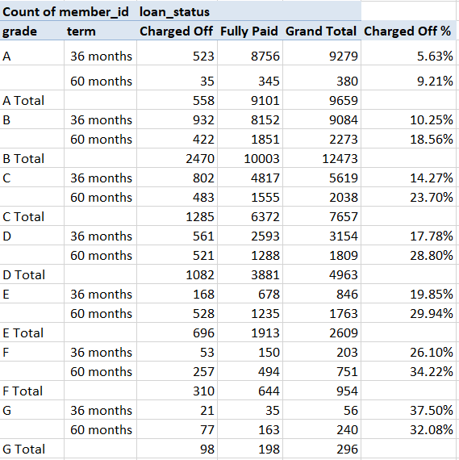
Driving Factor : Grade EDA Type: Multivariate Analysis (Grade-Term-Loan status) Graph Type: Pivot Table Analysis: From the pivot table as the grade going forward i.e. A-> G, the percentage of charged off applicants across both 36, 60 months terms is high.

Slide 6
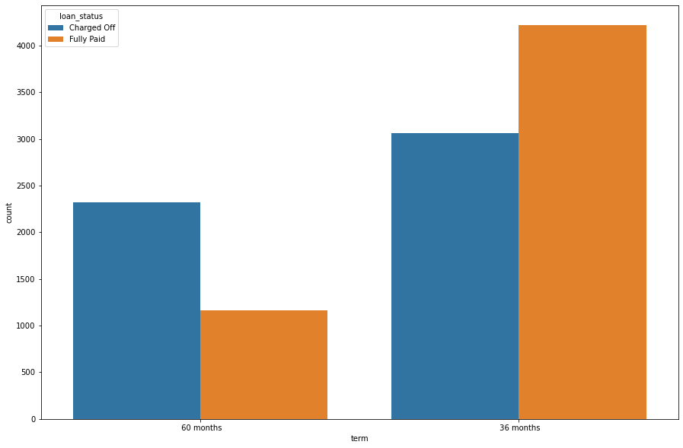
Driving Factor : Term EDA Type: Bivariate Analysis (Applicant Count-Loan status) Graph Type: Bar Chart -Count Plot Analysis: From the Count plot, it can be clearly observed that applicants with higher term has high percentage of getting charged off.

Slide 7
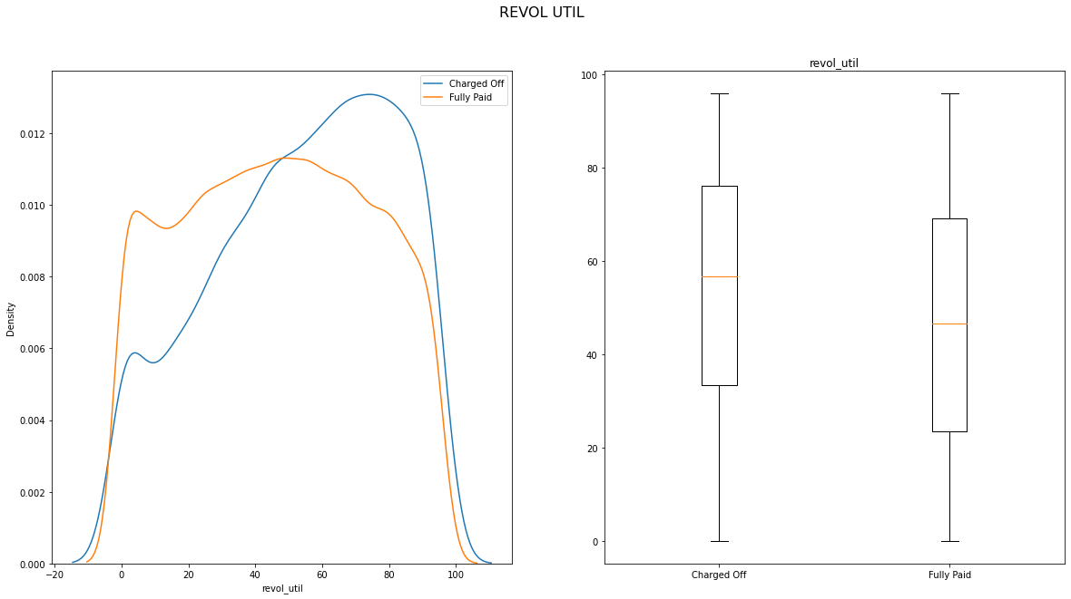
Additional Driving Factor : revol_util (In the case – If Institutions have possibility of having this customer behaviour variable at time of loan application) EDA Type: Univariate Analysis Graph Type: Density Plot, Box Plot Analysis: 1. As revol_util increases the charged off graph is more flat and linearly moves forward. 2. In Box plot the 25%,median and 75% are relatively high for charged off applicants. For high revol_util the chance of defaulting is high.

Slide 8
Thank You
Driving Factors:
1. Interest rate (int_rate)
2. Purpose
3. Grade
4. Term
Additional Driving Factor:
1. revol_util
11-05-2022
IIIT-B - UpGrad

